Slide 1
Abdominal Pain in Children
Dr Helen Goodyear, Consultant Paediatrician HEFT and Associate Postgraduate Dean HEE (wm)

Slide 2
What are the causes of abdominal pain in children?

Slide 3
Causes
Acute Chronic
Gastroenteritis Constipation
Appendicitis Functional abdominal pain
UTI / pyelonephritis Infantile colic
Intussusception Gastro-oesophageal reflux
Surgical causes H pylori infection and ulcers
Coeliac disease
Mesenteric adenitis
Abdominal migraine
Ovarian pathology
Inflammatory bowel disease
Other – liver, gallbladder, neoplasia eg Wilms

Slide 4
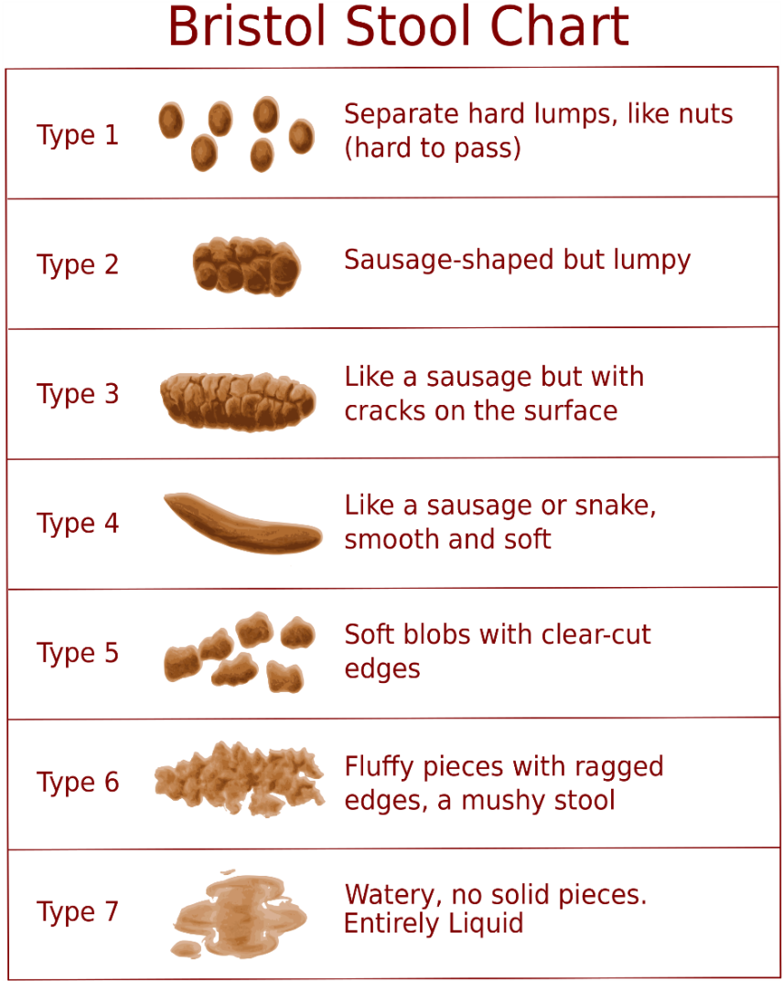
History
When did it begin?
Where is the pain?
How often does it come/any pattern to pain?
Any associated symptoms/diet?
Family history/life events
School – how is it going and attendance record
Travel history (vaccinations/malaria R_{x} if been abroad)
Bowels – use Bristol stool chart
What do parents/child think this is?

Slide 5
Examination
General physical examination
Mouth – for ulcers/cobblestone appearance of buccal mucosa
Eyes for anaemia and jaundice
Hands for clubbing
Anus – no PR in a child but inspect for skin tags, fissures etc
Genitalia
Dipstick urine
Plot height and weight on a centile chart

Slide 6
Normal findings
Reassurance
Monitor growth and school attendance
If persists and family not reassured then do FBC, U+Es, LFTs, ESR, CRP, coeliac screen + IgA
AXR not usually helpful
Ultrasound has virtually no yield unless specific pathology is suspected from history and examination.

Slide 7
Gastroenteritis
Seek history of travel
Stool for virology, culture
Campylobacter jejuni – can have bloody diarrhoea. Tends to be young children. Usually self limiting but treat with erythromycin if severe, persistent or child < 2 years of age
Clostridium difficile - stop antibiotics; treat with vancomycin or metronidazole
Salmonella enteritidis – antibiotics not recommended except if 3 months of age or bacteraemia
E coli including 0157 – haemolytic uraemic syndrome
Giardia lambia – treat with metronidazole
Hepatitis A

Slide 8
UTI/Pyelonephritis
NICE guidelines - https://www.nice.org.uk/Guidance/CG54
Clean catch sample
Dipstick testing
Renal ultrasound only if <6months, atypical infection in older children or recurrent

Slide 9
Intussuception
1 in 250 infants
Invagination of one part of bowel into adjacent bowel
Peak incidence 6-9 months; other ages with underlying factor eg Meckels
Colicky pain, drawing up of legs, vomiting becoming bilious
Can sometimes feel sausage shaped mass in abdomen
Redcurrant jelly stools occur as progresses
Refer immediately as need fluid resuscitation
Can be more chronic
Reduction non-operative or operative with resection if bowel non-viable

Slide 10
Constipation
Common affecting up to 20% of children
Functional (most common) or physical basis
Delayed passage of meconium (>48 hours) think about Hirschsprung disease, anal stenosis, neuromuscular disorders
Normal meconium passage, normal stools for a few weeks then difficulty passing think of atopy related anal spasm
Normal stools until after the first year of life then functional including anal fissure and behavioural disturbances
Poor fluid and food intake
Examine spine, sacrum and lower limb reflexes
Rule out coeliac disease and hypothyroidism
Other investigations eg Sweat test if child failing to thrive, RAST IgE may be appropriate

Slide 11
Treatment of constipation (functional)
Stool softeners eg Movicol, lactulose, sodium docusate
Prokinetics eg Sennokot and sodium picosulphate
Enemas only deal with faecal masses and can make fear of defaecation worse
Initial treatment is softening and evacuation of retained stool
Maintenance Movicol (remember chocolate flavour), senna once daily to prevent reaccumulation
Dieatry input – involve dietician
Dietary exclusions if suspect atopic related food related colitis
Treatment needed for 12 months or longer to prevent reaccumulation
Osmotic | Stimulant
Lactulose | Senna
Phosphate enemas | Docusate sodium
Sodium citrate enemas | Sodium picosulphate
 | Biscodyl
 | Microlax enema

Slide 12
Disimpaction regime
Movicol Paediatric – increasing by 2 sachets every 2 days
1-5 years up to 8 sachets – start with 2 sachets
6-12 years up to 12 sachets – start with 4 sachets
Enemas are not a first line treatment and should only be used if other disimpaction methods have failed

Slide 13
Recommended fluid intake if hot, exercising or obese need more
 | Total water intake per day, including water contained in food | Water obtained from drinks per day
Infants 0–6 months | 700 ml assumed to be from breast milk
7–12 months | 800 ml from milk and complementary foods and beverages | 600 ml
1–3 years | 1300 ml | 900 ml
4–8 years | 1700 ml | 1200 ml
Boys 9–13 years | 2400 ml | 1800 ml
Girls 9–13 years | 2100 ml | 1600 ml
Boys 14–18 years | 3300 ml | 2600 ml
Girls 14–18 years | 2300 ml | 1800 ml

Slide 14
Functional abdominal pain
Recurrent abdominal pain in up to 1 in 10 children
Many cases are “functional”
More than 3 attacks of pain over more than 3 months interfering with normal activities
Peaks 4-6 years and in early adolescence, especially girls >12 years
Likely if physical findings inconsistent eg extreme tenderness on superficial palpation yet can move in an unrestricted way
Psychosocial history important
Pharmacological approaches unlikely to help. Behavioural R_{x} – CBT, hypnotherapy. Rehabilitation to school and peers. Inconclusive evidence regarding lactose free diet and fibre supplements
Improves with age but high proportion have symptoms continuing into adult life

Slide 15
Coeliac disease
2-3% population
Associated with other autoimmune conditions - Insulin dependent diabetes and hypothyroidism
Presentation can include non-specific abdominal pain as well as more classical presentation
Anti -TTG tissue tranglutaminase – remember IgA deficiency
Diagnose - Blood TtG antibodies >10 times upper limit of normal + IgA endomysial antibody positive and HLA-DQ2 or HLA-DQ8 plus symptoms resolve on gluten free diet. If doubt exists small intestinal biopsy is needed
Association with small intestinal lymphoma later in life possibly increased if continue to ingest gluten
Iron deficiency anaemia , low albumin may occur
Needs dietician support to exclude wheat rye and barley; oats tend to be gluten free in pure form

Slide 16
Infantile colic
Common
May be transient lactose intolerance
Excessive crying in healthy thriving infant <3 months. From 4 weeks of age. Occurs in the evening and persists for > 3 hours a day more than 3 days per week for at least 3 weeks
Reassure family
Try excluding cow’s milk from diet with hydrolysed formula; mother exclude cow’s milk from diet if breast feeding
Resolves spontaneously by 4-5 months of age

Slide 17
Gastro-oesophageal reflux
Commonest cause of chronic vomiting in infancy
May occur in prepubertal children prior to growth spurt when they have gained weight
Poor feeding , poor weight gain
Excessive posseting and regurgitation of feeds, older children gag on lumpy foods, small appetite, epigastric pain and dysphagia
Food may be chewed for an excessive time
Treatment
Healthy infants – positioning, thicken feeds with Carobel, Gaviscon.
May need H₂ antagonist and/or proton pump inhibitor
Infantile reflux usual asymptomatic by second year of life

Slide 18
Inflammatory bowel disease – Ulcerative Colitis
Lower colicky abdominal pain
Weight loss
Stool urgency
Bloody diarrhoea and mucus
May present with severe fulminating colitis with toxic megacolon –
Vomiting,
Tachycardia,
Pyrexia,
Severe abdominal pain

Slide 19
Inflammatory bowel disease – Crohn’s disease
Insidious onset
Loss of appetite
Weight loss and poor growth
Abdominal pain
Diarrhoea
Examination findings may include – mouth ulcers, erythema nodosum, perianal region affected including erythema and fissuring, cobblestone appearance to buccal mucosa, uveitis
May affect any part of GI tract

Slide 20
H Pylori infection and ulcers
Common worldwide, rare <14 years in developed countries
Epigastric pain often waking at night and vomiting
Treatment is with a 2 week course of triple therapy including either H2 antagonist or PPI plus 2 antibiotics
Duodenal ulcers associated – treat as for H Pylori with excellent prognosis
Gastric ulcers are rare usually secondary to other disorders

Slide 21
Irritable bowel syndrome
Usually adults first appearing age 20-30
Crampy abdominal pain and discomfort, comes and goes often relieved by passing stool
Change in stool, diarrhoea or constipation or both and mucus in the stool together with sensation of not emptying bowels fully and urgency
May be bloating and flatulence
Symptoms for several months – at least once per week for 2 months
Triggers include stress, anxiety, certain foods
Treatment includes dietary manipulation, fibre, anti-diarrhoeal agents, laxatives, antispasmodics, antidepressants

Slide 22
Summary
History
Examination
Most do not need investigations

