Slide 1
Management of Neck Lumps
David Howe
Consultant ENT Surgeon
Heart of England Foundation Trust
Spire Parkway

Slide 2
What to cover?
Common neck lumps
What the likely pathology is
Initial investigations and management
Red Flags

Slide 3
How to approach
assessment
History - consider age of patient
Duration of mass, has it changed?
Pain ? referred
Associated symptoms eg swallowing/voice issues
Risk factors eg smoking, immunosuppression, previous RT

Slide 5
Location of key structures
Thyroid
Major salivary glands
Lymphatic groups
Thyroglossal duct cysts
Branchial cysts
Dental sepsis
Direct spread of tumours

Slide 6
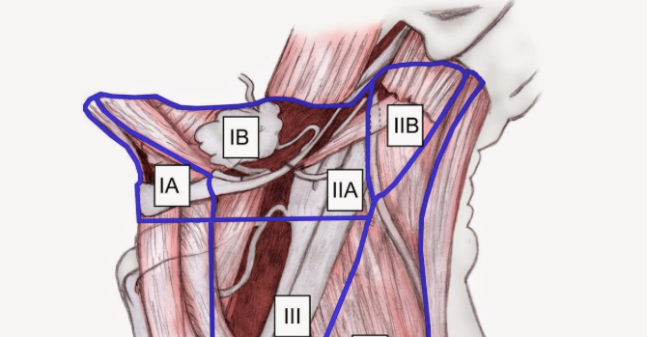
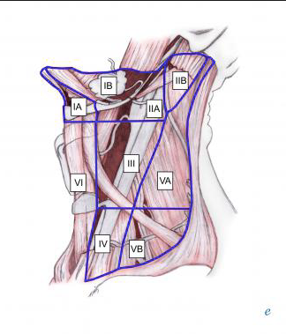
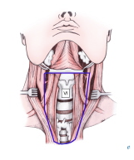
Mandatory Anatomy slide!!

Slide 7
Salivary lesions
Glands in order of frequency
Parotid
Submandular then Sublingual
Minor salivary
Rates of malignancy affected by gland type
Parotid lesions approximately 80% benign
Submandibular gland and others 50% risk of malignancy

Slide 8
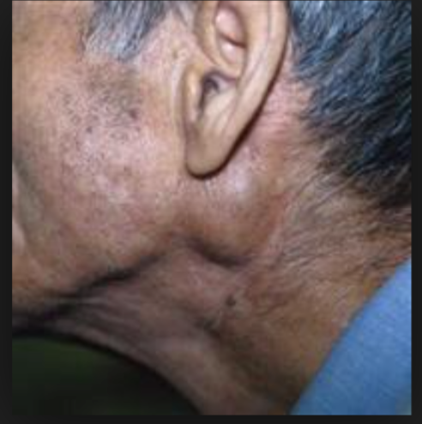
Parotid
Commonly pleomorphic adenoma circa 60%
Has small risk of malignant potential
Hence patients offered surgery (also to confirm pathology)
Warthins tumours - entirely benign, common in smokers and often bilateral, tail of parotid.
Malignancy, primary or met (often from skin e.g. scc)
Prognosis and treatment dependant on grade of tumour

Slide 9
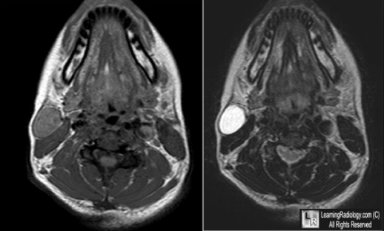

Slide 10
Submandibular masses
Most common site for a calculus
Often show up on uss but sometimes requires ct
Treatment options - conservative, endoscopic, open
Tumours, benign generally a PA, remember 50% rate of malignancy.
Assess with USS and probably FNA
Surgery generally primary treatment.

Slide 11
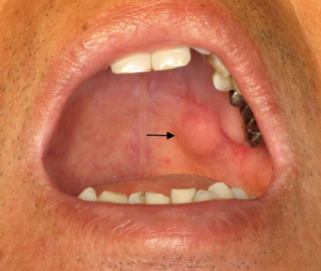
Minor salivary lesions
Generally noticed on per oral inspection - often by the patient.
I would suggest refer in as they need biopsy (60-80% malignant)
Floor of mouth swelling around submandibular duct could be a calculus or a sublingual tumour or ranula.

Slide 12
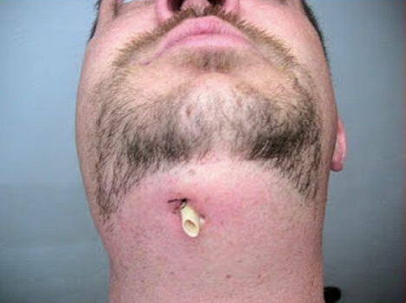
Dental Sepsis
Increasingly common!! Dearth of NHS dentistry
Patients presenting with deep space neck infections and swellings under mandible
Particularly consider this in submental swellings and those with discharge
Look at teeth, consider OPG and dental review
Often need tooth removing to resolve problems

Slide 13
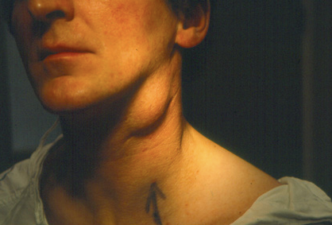
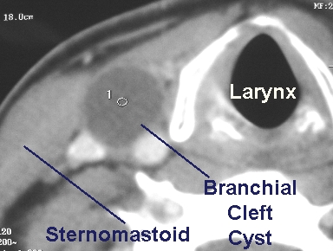
Branchial cyst
Common presentation of sudden swelling in level 2/3 of neck
Occurs in late teens and early 20’s
Can occur later in life but in age over 40 consider possible sinister causes.
Recommend referral and removal if indicated or wanted.

Slide 14
Younger age group, benign lesion ? cystic degeneration of lymph node.
Over 40’s likely to be benign, but possibility of cystic metastasis from a SCC
Therefore more extensive workup in higher risk group and often pet scan undertaken
Objective to identify potential primary lesion and avoid surgery to neck unless therapeutic.
Definitely consider 2WW referral for these, particularly in over 40’s
Most turn out to be benign, very rarely a cystic metastasis from a thyroid cancer

Slide 15
Lymph nodes
Can be difficult sometimes to prove there is nothing of concern
Worries about over/under investigating
Possible risk of not identifying a low grade/quiescent lymphoma
Limitations of both imaging/biopsy/clinical assessment
Risks of lymph node biopsy not inconsiderable

Slide 16
Consider
Age
Duration and associated symptoms
Risk factors
Size definitely matters!!!!
Location of nodes is important, particularly supraclavicuar and posterior triangle
Careful assessment of throat and ask about pain/swallowing issues etc as patient may not volunteer them

Slide 17
Investigations
Could simply refer
If low risk/clinical concern
Baseline bloods/USS
How long to allow to improve??
Patient anxiety

Slide 18
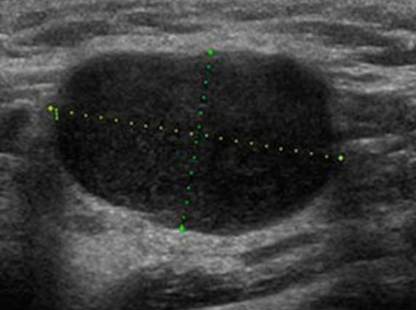
USS of lymph nodes
Operator dependant!!
Description sometimes difficult to lead management.
But - a reactive node should retain a fatty hilum, be ovoid in shape and have a normal vascular pattern despite being enlarged
Morphologically abnormal nodes need further investigation, sometimes reactive nodes can look like this and subsequently improve.

Slide 19
Role of referral
Allows nasoendoscopy and comprehensive assessment of throat
Consideration of fna
May require open lymph node biopsy
Limitations of fna in neck nodes, may give an indication of high grade lymphoma but not diagnostic and either a core biopsy or open biopsy needed.
Can infer if likely to be granulomatous e.g. TB
Node maybe related to either a systemic metastasis or unknown primary lesion

Slide 20
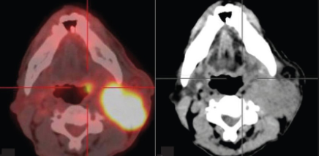
Unknown primary
Carcinoma in lymph node with no primary evident
May be head and neck primary levels 1-4
Distant primary more likely in supraclavicular node - lung/bowel/renal etc
Role of cross sectional imaging and PET scan
Head and neck primary often an occult tonsillar tumour or tongue base primary

Slide 21
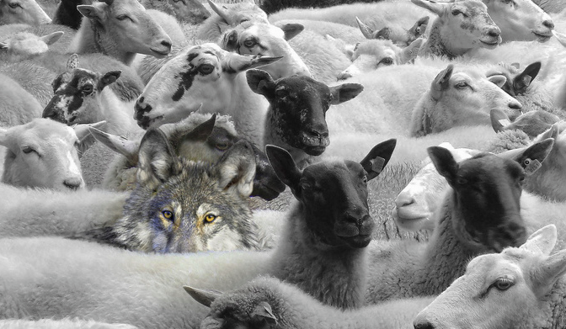
Thyroid Nodules
Thyroid Nodules are very common circa 45% of female population age over 50 have thyroid nodules
Malignancy relatively rare.
2010 Annual incidence in the UK 5.1 per 100,000 women cf 2.3 in 1971-95 (Cancer Registry)
900 new cases and 250 deaths recorded in England and Wales per year

Slide 22
Most common endocrine malignancy
Only 1% of all malignancies
Increasing incidence of PTC - much of this incidental micro papillary carcinoma (<1cm) or lower stage cancers
Overall mortality from thyroid cancer unchanged for many years

Slide 23
In Primary Care - What do USS reports mean
USS report should hopefully recommend referral to a specialist if there are concerning thyroid lesions.
Potential difficulty if report has no explicit U classification and simply descriptive text regarding echogenicity of nodules - what does that mean???
Strong family history/previous radiation exposure
High TSH - association with increased risk of cancer
Suggest - U2 nodules and euthyroid probably don't require investigation -subjective
U3 upwards need referral as per 2WW
Compressive symptoms/goitre - consideration for decompressing surgery

Slide 24
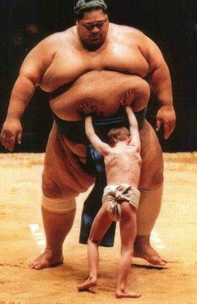
Does size matter??
Historically as the size of the nodule increased in size the reliability of biopsies and scans reduced.
Probably minimal increased risk of cancer just uncertainty
This still applies

Slide 25
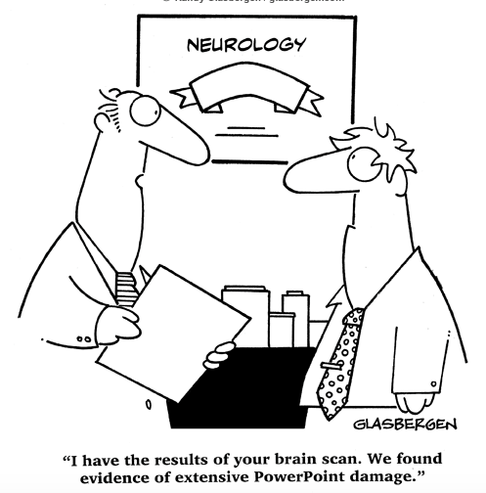
Imaging is key to investigation of nodules

Slide 26
New Guidelines
Aim of guidelines - to reduce unnecessary investigation cost - lots of nodules, most benign
Big cost implication for healthcare system
Thyroid Nodules are now classified based on USS Appearance
Low risk (benign lesions) - U1/U2 considered benign
No further investigation needed
Higher risk U3/U4/U5 progressive increasing risk of cancer
Require a biopsy and possibly surgery
Introduced in 2014
New system - entirely dependant on radiology opinion.
Subjective interpretation of USS findings - need to consider thyroid specialist radiologist
Reclassification of USS appearance frequently at mdt - important as this can determine if a biopsy is even done!

Slide 27
Indications for Surgery
Concern regarding malignant nature of nodule
Compressive consequences of a large goitre - normal tracheal compression
Thyrotoxicosis
Cosmetic - not generally recommended although often requested!!!

Slide 28
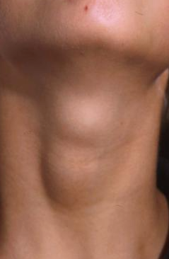
Case Study
40 year lady
Neck lump incidental
No family history
What next?

Slide 29
History
Often of minimal influence in thyroid management
Strong FHx/radiation exposure
Voice change very rare even with malignancy
Haemoptysis -very rare
Compressive symptoms?
Symptoms of thyroid dysfunction

Slide 30
Investigations
Bloods
TFTs - if toxic consider endocrine referral - maybe a toxic nodule (low chance of malignancy)
Thyroid antibodies - helpful for interpretation of uss and biopsy findings (pseudo tumour)

Slide 31
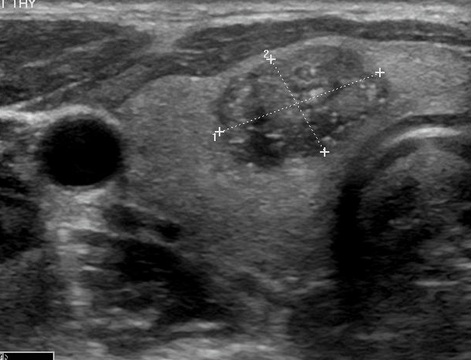
Ultrasound
USS finding 3cm hypo echoic, well defined nodule, some intralesional vascular flow (U3). Rest of thyroid normal
What next?

Slide 32
Management - will require biopsy - therefore refer
USS FNA
FNA scored Thy 1 -5 -needs MDT review
This lesion thy 3f (unable to refine between benign and malignant lesions)
Therefore offer diagnostic lobectomy
Risk of malignancy approximately 25% in this situation

Slide 33
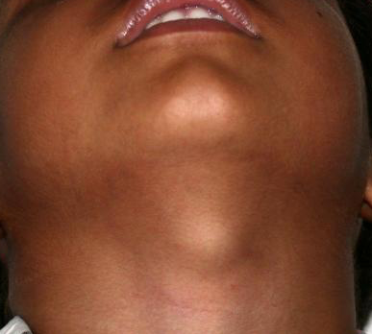
Thyroglossal duct cyst
Commonest in childhood and young adults
Can be complicated by infection
Malignancy very rare but reported
Investigation of choice - use
Check for normal thyroid tissue
Surgery not essential

Slide 34
Acute swellings
Lymph nodes - probably inflammatory, can become necrotic and form an abcess particularly in infants ? I&D
Thyroid cysts - spontaneous bleed and swell ? coughing fit
Deep neck infection, potential life threatening!!! From quinsy, fb or dental source typically
Often need ITU or tracheostomy and agressive Abx therapy

Slide 35
Summary
Position of neck lump informs likely pathology
Risk factors key
Consider red flags - pain, voice change, swallowing, B symptoms
Early referral suggested if concern (2WW)
USS often helpful first line investigation

Slide 36
