Slide 1
New (Direct)Oral anti-coagulants in the treatment of VTE
Dr NA Smith - Haematology Dept
Heart of England NHS Foundation Trust

Slide 2
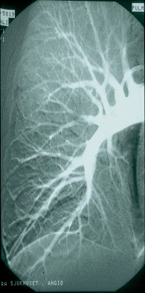
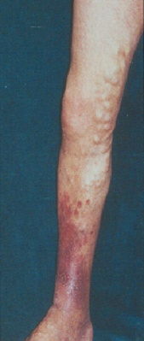
Venous thromboembolism (VTE)
DVT
PE
Deep vein
insufficiency
Pulmonary
hypertension
Death
Post-thrombotic
syndrome
Venous Ulcers
Crude mortality 15-20% within 3 months of diagnosis

Slide 3
Total VTE's HEFT (FY 2014-2015)

Slide 4
NOACs
What are they
Are they good
Are they safe
How much are we using
How much will we be using

Slide 5
New VTE anticoagulation issues
Duration of treatment
DASH score
Unprovoked vs Provoked
Hospital associated thrombosis (HATs)

Slide 6
New Oral Anticoagulants (NOAC)
Dabigatran - NICE (SPAF) March 2012
NICE (VTE) Dec 2014
Rivaroxaban - NICE (SPAF) May 2012
NICE (VTE) July 2012
NICE (ACS) March 2015
Apixaban - NICE (SPAF) Feb 2013
  NICE (VTE) June 2015
Edoxaban - NICE (SPAF) Aug 2015
(VTE) Aug 2015

Slide 7

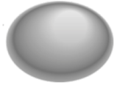













Old drugs
Warfarin (VKA’s) Reduction in production of factors II, VII, IX and X
VII
TF
VIIa
X
IX
Inactive factor
Xa
IXa
Active factor
Transformation
II
Prothrombin
AT
Catalysis
Heparins
Indirect inhibition
via potentiation of
Anti-thrombin III
IIa
Thrombin
Clot formation
Fibrinogen
Fibrin
Adapted from Spyropoulos AC. Expert Opin Investig Drugs 2007;16:431–440
Notes:
Methods of VTE treatment
7
LMWH is an indirect inhibitor of Factor Xa and thrombin
This slide shows a simplified model of the coagulation pathway.¹
LMWHs act via AT to inhibit Factor Xa and thrombin²
LMWH shows increased inactivation of Factor Xa compared with UFH²
LMWHs have less effect against thrombin relative to Factor Xa²
1. Spyropoulos AC. Expert Opin Investig Drugs 2007;16:431–440
2. Ansell J et al. Chest 2008;133:160S–198S

Slide 8
Direct Factor IIa & Xa inhibitors
DOACs or NOAC’s!
Inactive factor
TF
VIIa
VII
Active factor
X
IX
Transformation
Catalysis
Direct Factor Xa inhibition
Rivaroxaban
Apixaban
Edoxaban
Xa
IXa
II
Prothrombin
Direct Factor IIa inhibition
Dabigatran etexilate
IIa
Thrombin
Fibrinogen
Fibrin
Adapted from Spyropoulos AC. Expert Opin Investig Drugs 2007;16:431–440
Notes:
Methods of VTE treatment
8
Direct Factor Xa inhibitors
This slide shows a simplified model of the coagulation pathway.
Many more recently developed anticoagulants are aimed at inhibition of Factor Xa, although other targets in the coagulation pathway are currently being investigated with investigational and licensed drugs
Factor Xa is an attractive target for anticoagulation because it plays a key role in the coagulation process and no thrombin can be generated without Factor Xa
Several direct Factor Xa inhibitors are either licensed or in development. These include rivaroxaban, licensed for the prevention of stroke and systemic embolism in adult patients with non-valvular atrial fibrillation withone or more risk factors, such as congestive heart failure, hypertension, age ≥ 75 years, diabetes mellitus, prior stroke or transient ischaemic attack and also licensed for the prevention of venous thromboembolism (VTE) in adult patients undergoing elective hip or knee replacement surgery², and apixaban also for the prevention of venous thromboembolic events (VTE) in adult patients who have undergone elective hip or knee replacement surgery³.
References
Spyropoulos AC. Expert Opin Investig Drugs 2007;16:431–440
Rivaroxaban SMPC 2011
Apixaban SMPC 2011

Slide 9
New Agents
Charecteristic | Dabigatran | Rivaroxaban | Apixaban
target | Thrombin (IIa) | F Xa | FXa
Prodrug | Yes | No | No
Bioavailability | 6% | 60-80% | 60%
Dosing | BD | OD | BD
Time to peak | 1-3 hr | 2-4 Hr | 1-2 Hr
Half-life | 8 – 15 hr | 7 – 11 hr | 12 hr
Renal Clearance | 80% | 33% | 25%
Interactions | P-gp | 3A4 / P-gp | 3A4 / P-gp

Slide 10
EINSTEIN DVT: primary efficacy outcome - Time to first event
4.0
Enoxaparin/VKA (n=1,718)
3.0
Rivaroxaban (n=1,731)
Cumulative event rate (%)
2.0
HR=0.68; p<0.001
1.0
0
0
30
60
90
120
150
180
210
240
270
300
330
360
Time to event (days)
The EINSTEIN Investigators. N Engl J Med 2010;363:2499–2510
Notes:
EINSTEIN DVT: primary efficacy outcome – time to first event
The time course of recurrent VTE in the two treatment groups during the EINSTEIN DVT study is shown in this slide:
By day 21 (the end of rivaroxaban bid dosing), the primary efficacy outcome had occurred in 1.2% of rivaroxaban-treated patients and in 1.7% of enoxaparin/VKA-treated patients
Over the course of the study, the primary efficacy outcome occurred in 2.1% of patients treated with rivaroxaban, compared with 3.0% of patients treated with enoxaparin/VKA (HR=0.68; 95% CI 0.44–1.04; p<0.001 for non-inferiority)
Reference
1. The EINSTEIN Investigators. N Engl J Med 2010;363:2499–2510

Slide 11
EINSTEIN-DVT: primary efficacy outcome and key safety outcomes
EINSTEIN-DVT trial: open-label, randomised trial comparing rivaroxaban treatment
(15 mg twice daily for 21d, then 20 mg once daily for 3, 6 or 12 months) with enoxaparin bridging to VKA therapy in patients with acute symptomatic DVT
 | Rivaroxaban (n=1,731) | Enoxaparin/VKA (n=1,718) | HR (95% CI) | P Value
Primary efficacy outcome (mean study duration: ~9 months)
Recurrent VTE, n (%) | 36 (2.1) | 51 (3.0) | 0.68 (0.44‒1.04) | <0.001 Non-inferiority
 | Rivaroxaban (n=1,718) | Enoxaparin/VKA (n=1,711) | HR (95% CI) | P Value
Safety outcomes
Major or CRNM bleeding, n (%) | 139 (8.1) | 138 (8.1) | 0.97 (0.76‒1.22) | 0.77
Major bleeding, n (%) | 14 (0.8) | 20 (1.2) | 0.65 (0.33‒1.30) | 0.21
0
1
2.0
Favours rivaroxaban
Favours enoxaparin/VKA
The EINSTEIN Investigators. N Engl J Med. 2010;363:2499–2510.

Slide 12
EINSTEIN-PE: primary efficacy outcome and key safety outcomes
EINSTEIN-PE trial: open-label, randomised trial comparing rivaroxaban treatment
(15 mg twice daily for 21d, then 20 mg once daily for 3, 6 or 12 months) vs enoxaparin + VKA therapy in pts with acute symptomatic PE with or without symptomatic DVT
 | Rivaroxaban (n=2,419) | Enoxaparin/ VKA (n=2,413) | HR (95% CI) | P Value
Primary efficacy outcome (mean study duration: ~9 months)
Recurrent VTE, n (%) | 50 (2.1) | 44 (1.8) | 1.12 (0.75‒1.68) | 0.003 Non-inferiority
 | Rivaroxaban (n=2,412) | Enoxaparin/ VKA (n=2,405) | HR (95% CI) | P Value
Safety outcomes
Major or CRNM bleeding, n (%) | 249 (10.3) | 274 (11.4) | 0.90 (0.76‒1.07) | 0.23
Major bleeding, n (%) | 26 (1.1) | 52 (2.2) | 0.49 (0.31‒0.79) | 0.003
0
1
2.0
Favours rivaroxaban
Favours enoxaparin/VKA
The EINSTEIN-PE Investigators. N Engl J Med. 2012;366:1287–1297.

Slide 13
Apixaban in VTE –Amplify study
Randomised, double-blind active-controlled, non-inferiority study
To evaluate the efficacy and safety of apixaban alone with conventional anticoagulant therapy (enoxaparin/warfarin) for 6 months in patients with acute symptomatic DVT and/or PE
Enoxaparin
(1 mg/kg) BD SC
N=2704
Warfarin (INR 2–3)
acute symptomatic proximal DVT
and/ or PE
N=5400 (randomised)
R
End of treatment
30-day safety follow-up
Apixaban twice daily
N=2691
10 mg BD
5 mg BD
Time:
D1
D7
6 months
  Stratification based on DVT and PE; randomisation target was two-thirds DVT and one-third PE
Agnelli et al. N Engl J Med 2013; 369:799–808.

Slide 14
AMPLIFY: recurrent VTE or VTE-related death
Primary efficacy outcome
Enoxaparin/warfarin
(events: 71/2,704)
3
2
Apixaban
(events: 59/2,691)
Cumulative event rate (%)
1
For warfarin-treated subjects,
TTR was 61%
RR 0.84 (95% CI, 0.60–1.18)
P<0.001 (non-inferiority)
0
0
30
60
90
120
150
180
210
240
270
300
Days to VTE/VTE-related death
No. of patients at risk
Apixaban
2,691
2,606
2,586
2,563
2,541
2,523
62
4
1
0
0
Eno/war
2,704
2,609
2,585
2,555
2,543
2,533
43
3
1
1
0
  Eno, enoxaparin; TTR, time in therapeutic range; War, warfarin.
Agnelli et al. N Engl J Med. 2013;369:799–808.

Slide 15
AMPLIFY: major bleeding
Primary safety outcome
2
Enoxaparin/warfarin (events: 49/2,689)
ARR 1.2% RR 0.31 (95% CI, 0.17–0.55) P<0.001 (superiority)
1
Cumulative event rate (%)
Apixaban (events: 15/2,676)
0
0
30
60
90
120
150
180
210
240
270
300
Days to major bleeding
No. of patients at risk
Apixaban
2,676
2,519
2,460
2,409
2,373
2,339
61
4
1
0
0
Eno/war
2,689
2,488
2,426
2,383
2,339
2,310
43
3
1
1
0
Agnelli et al. N Engl J Med. 2013;369:799–808.

Slide 16
AMPLIFY: major bleeding vs enoxaparin/warfarin
Major bleeding*
Major or CRNM bleeding*
RR (95% CI)
0.31 (0.17–0.55)
P<0.001 for superiority
69% RRR
RR (95% CI)
0.44 (0.36–0.55)
P<0.001
56% RRR
12
10
9.7%
261/
2,704
8
6
Patients with event (%)
4.3%
4
115/
2,691
2
1.8%
0.6%
49/2,689
0
15/2,676
Apixaban
Enoxaparin/warfarin
Apixaban
Enoxaparin/warfarin
CRNM, clinically relevant non-major; RRR, relative risk reduction.
* For patients who had >1 event, only the first event was counted.
Agnelli et al. N Engl J Med. 2013;369:799–808.

Slide 17
AMPLIFY: primary efficacy outcome and key safety outcomes
AMPLIFY trial was a double-blind, randomised trial comparing 6 months of apixaban treatment with enoxaparin bridging to warfarin therapy in patients with acute symptomatic DVT and/or PE
 | Apixaban (n=2,609) | Enoxaparin/ warfarin (n=2,635) | RR (95% CI) | P Value
Primary efficacy outcome
Recurrent VTE or VTE-related death, n (%) | 59 (2.3) | 71 (2.7) | 0.84 (0.60–1.18) | <0.001 Non-inferiority
 | Apixaban (n=2,676) | Enoxaparin/ warfarin (n=2,689) | RR (95% CI) | P Value
Safety outcomes
Major bleeding, n (%) | 15 (0.6) | 49 (1.8) | 0.31 (0.17–0.55) | <0.001
Major or CRNM bleeding, n (%) | 115 (4.3) | 261 (9.7) | 0.44 (0.36–0.55) | <0.001
0
1
2.0
Favours apixaban
Favours enoxaparin/warfarin
HR, hazard ratio.
Agnelli et al. N Engl J Med. 2013;369:799–808.

Slide 18
RE-COVER: primary efficacy outcome and key safety outcomes
RE-COVER trial was a double-blind, double-dummy, randomised trial comparing 6 months of dabigatran treatment (150 mg twice daily) with heparin* bridging to dose-adjusted warfarin therapy in patients with acute symptomatic DVT and/or PE
 | Dabigatran (n=1,274) | Heparin*/ warfarin (n=1,265) | HR (95% CI) | P Value
Primary efficacy outcome
Recurrent VTE or VTE-related death, n (%) | 30 (2.4) | 27 (2.1) | 1.10 (0.65‒1.84) | <0.001 Non-inferiority
 | Dabigatran (n=1,273) | Heparin*/ warfarin (n=1,266) | HR (95% CI) | P Value
Safety outcomes†
Major bleeding, n (%) | 20 (1.6) | 24 (1.9) | 0.82 (0.45‒1.48) | NS
Major or CRNM bleeding, n (%) | 71 (5.6) | 111 (8.8) | 0.63 (0.47‒0.84) | 0.002
0
1
2.0
Favours dabigatran
Favours warfarin
*LMWH, UFH, or fondaparinux.
†The safety analysis of bleeding events was performed on the basis of the number of patients treated with dabigatran (1,273) or warfarin (1,266), rather than the number assigned to the treatment (1 patient who was assigned to receive dabigatran mistakenly received warfarin instead throughout the study). Events that occurred during the 6-month treatment period plus a 6-day washout period were included.
NS, not specified
Schulman et al. N Engl J Med. 2009;361:2342–2352.

Slide 19
Rivaroxaban
Initial choice for treatment of VTE c80%
Not used in massive PE likely to require thrombolysis
Do not use in:
Patients with GI problems likely to bleed
Patients with CKD GFR < 30 mls/min

Slide 20
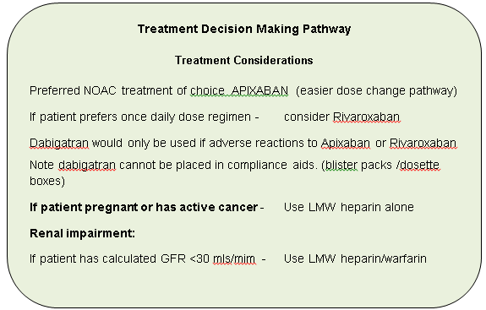
BHH Guidance

Slide 21
Type and duration of
VTE Treatment
New ACCP Guidance 2016
Use DOAC in preference to Warfarin/LMWH
Give initial 3 months for DVT and PE
Then assess risk of recurrence

Slide 23
VTE treatment type 2015-16 - HEFT

Slide 26
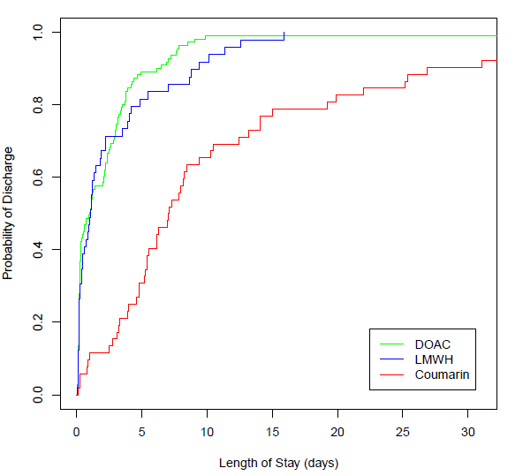
Length of Stay
DOAC vs LMWH vs Warfarin
DOAC assoc significantly decreased LOS vs Warfarin p < 0.003 (3.6x10⁻¹²)
LOS of DOAC vs. LMWH not significantly different p = 0.23

Slide 27
Costings – NICE TA 287
Duration of treatment | Rivaroxaban Cost | Clexane cost | Warfarin Cost | Monitoring costs | VKA/LMWH total
3 months | 235 | 98 | 5 | 127 | 230
6 months | 428 | 98 | 10 | 190 | 298
12 months | 811 | 98 | 29 | 318 | 445
NICE TA287: https://www.nice.org.uk/guidance/ta287/resources June 2013

Slide 28
Duration of anticoagulation

Slide 29
Duration of Treatment
New ACCP Guidance 2016
Use DOAC in preference to Warfarin/LMWH
Give initial 3 months for DVT and PE
Then assess risk of recurrence

Slide 30
Higher recurrence rates in unprovoked VTE
30
28.4%
25
p<0.001
Cumulative incidence of recurrent VTE (%)
20.5%
20
15
10
Provoked VTE
Unprovoked VTE
5
0
0
1
2
3
4
5
6
7
8
9
10
Years after first VTE
Data from patients with non-active cancer
Adapted from Martinez et al. Thromb Haem 2014; 112. ePub ahead of print.
Martinez et al. Thromb Haem 2014;112. ePub ahead of print.

Slide 31
Risk of recurrent VTE based on history of index event
Unprovoked
Non-surgical risk factor
Post-surgery
Risk of recurrence after unprovoked VTE 30-40% after 5-10 years
Cambridge cohort Baglin et al Lancet 2003; 362: 523–26

Slide 32
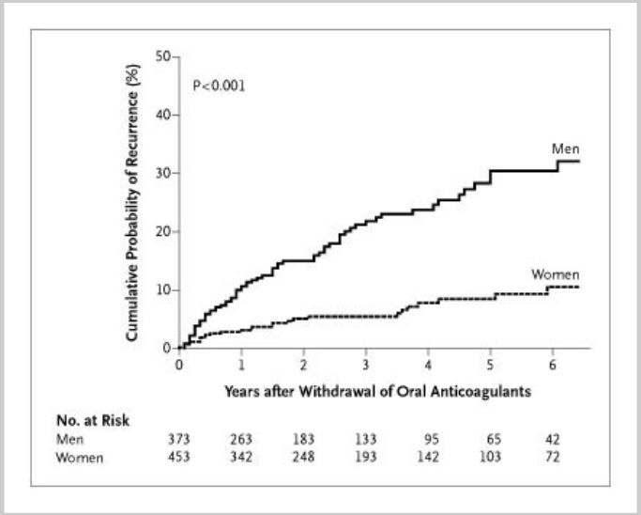
Recurrent VTE rates men vs women
(P<0.001
log-rank test).

Slide 33
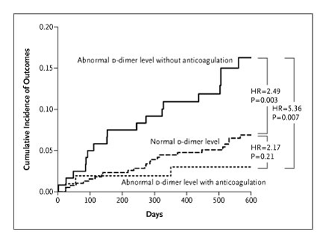
D dimer for prediction of VTE recurrence
Palaretti et al NEJM 2006;355:1780
Notes:
33
33
Abnormal DD in 223 / 608 patients (unprovoked VTE) randomised

Slide 34
DASH score : prediction of recurrence
DDimer - raised 2 points
Age - < 50 1 point
Sex - Male 1 point
Hormone related VTE -2 points

Slide 35
DASH score and recurrence rates
DASH Score | Recurrence risk – per year
0 | 2.4%
1 | 3.9%
2 | 6.3%
3 | 10.8%
4 | 19.9%

Slide 36
Reversal of DOACs

Slide 37
Idarucizumab - Praxbind
humanized monoclonal antibody fragment (Fab)
indicated for reversal of Dabigatran
Three randomized, placebo-controlled studies were conducted in a total of 283 healthy volunteers
  224 received at least one dose of PRAXBIND
  30 subjects were aged 65 years or older (median age=36 years)
12 subjects had mild renal impairment and 6 had moderate impairment†

Slide 38
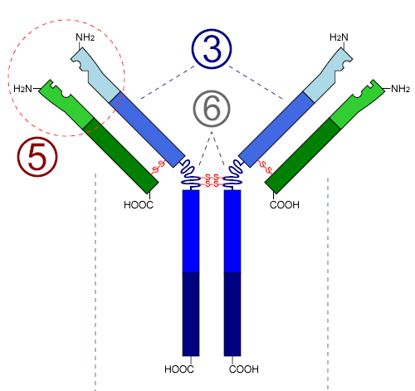




Idarucizumab development process
Monoclonal mouse antibody developed with high dabigatran binding affinity
Monoclonal antibody was then humanized and directly expressed as a Fab fragment in mammalian cells
Fab region
Mouse
Human
Fc region
Chimeric Fab
Humanized
Fab
Mouse antibody
van Ryn J. Presented at the AHA Congress, Los Angeles, USA. 5 November 2012. Presentation 9928; van Ryn J et al. Circulation 2012;126:A9928
UK/CVS-151023
Date of prep: July 2015
Notes:
The Fab region contains the part of an antibody that binds to an antigen and is highly variable between different antibodies
The Fc (constant) region is structural and interacts directly with the immune system; however, this non-specific binding is avoided by removal of the Fc region

Slide 39
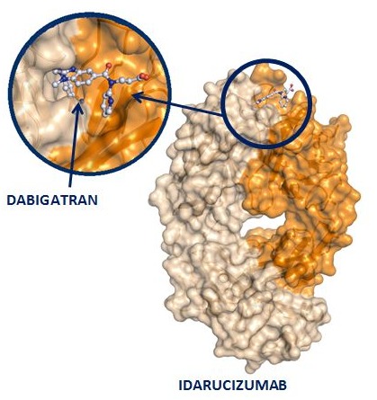
Idarucizumab characteristics
Fully humanized antibody fragment (Fab)
Binding affinity ~350× higher than dabigatran to thrombin
Dabigatran
No intrinsic procoagulant or anticoagulant activity
IV dosing by bolus infusion;
immediate onset of action
Short half-life
Idarucizumab
Schiele F et al. Blood 2013;121:3554-62; Pollack CV et al. Thromb Haemost 2015;114:198-205
UK/CVS-151023
Date of prep: July 2015
Notes:
Schiele F et al. Blood 2013;121:3554–62

Slide 40
Idarucizumab mode of action
Dabigatran bound to plasma proteins
Thrombin
Dabigatran inhibiting thrombin
Dabigatran molecule
Antidote
(idarucizumab)
Unbound
dabigatran
Idarucizumab alters the equilibrium – dabigatran dissociates from thrombin
Idarucizumab rapidly binds to
dabigatran in the plasma
UK/CVS-151023
Date of prep: July 2015
Notes:
1. When the antidote is administered it rapidly binds to the dabigatran in the plasma.
2. The introduction of idarucizumab alters the equilibrium, causing dabigatran to dissociate from thrombin and the dabigatran in other tissues to move into the plasma.
3. Due to the high binding affinity of the antidote to dabigatran, thrombin is left uninhibited and able to resume its normal role in the coagulation cascade.

Slide 41
Idarucizumab showed immediate, complete and sustained reversal of dabigatran anticoagulation
70
65
60
55
50
45
40
35
30
DE + placebo (n=9)
DE + 1 g idarucizumab (day 4) (n=9)
DE + 2 g idarucizumab (day 4) (n=9)
DE + 4 g idarucizumab (day 4) (n=8)
Normal upper reference limit (n=86)
Mean baseline (n=86)
dTT (sec)
DE + placebo
-2
0
2
4
6
8
10
12
24
36
48
60
72
Dabigatran
Time after end of infusion (hr)
Antidote
DE = dabigatran etexilate
Similar effects were seen for 5g + 2.5g dose(data not shown)
Glund S et al. Lancet. Jun 16, 2015. Epub ahead of print. Glund S et al. Presented at AHA, Dallas, TX, USA, 16-20 November 2013, Abstract 17765;
Normal upper reference limit’ refers to (mean+2SD) of 86 pre-dose measurements from a total of 51 subjects
Notes:
1. Complete reversal of anticoagulation activity (as measured by dTT) was seen immediately after antidote administration
2. Antidote 2 g and 4 g doses restored clotting activity to within the range seen before dabigatran dosing for the complete time frame (24 hrs)
3. The 1 g dose demonstrates that the effect of idarucizumab is dose-dependent. As expected, when only half of the equimolar dose is applied some return of anticoagulation is seen

Slide 42
Immediate, complete and sustained reduction of unbound dabigatran concentrations after idarucizumab infusion
Unbound dabigatran (mean + SD)
220
200
180
160
140
120
100
80
60
40
20
0
DE + placebo (n=9)
DE + 1 g idarucizumab (day 4) (n=9)
DE + 2 g idarucizumab (day 4) (n=9)
DE + 4 g idarucizumab (day 4) (n=8)
Lower limit of quantification (1 ng/mL)
DE + placebo
Unbound dabigatran (ng/mL)
LLOQ
-2
0
2
4
6
8
10
12
24
36
48
60
72
Dabigatran
Time after end of infusion (hrs)
Antidote
LLOQ = lower limit of quantification; SD = standard deviation; DE = dabigatran etexilate
Glund S et al. Lancet. Jun 16, 2015. Epub ahead of print. Glund S et al. Presented at AHA, Dallas, TX, USA, 16-20 November 2013, Abstract 17765;
Notes:
Unbound dabigatran approximates the pharmacologically active fraction in plasma
Reduction of dabigatran levels occurs immediately after administration of antidote
Antidote infusion reduced unbound dabigatran concentrations to, or below, the lower limit of quantification
2 and 4 g doses resulted in sustained reduction of mean unbound dabigatran concentrations

Slide 43
Results
5 g PRAXBIND, reduces dabigatran plasma concentrations below the lower limit of quantification
coagulation paramaters (dTT, ECT, aPTT, TT, ACT) return to baseline levels
Reduction in dabigatran observed over the entire observation period of ≥24 hours
In a limited number of patients, re‑distribution of dabigatran from the periphery to plasma led to re‑elevation of dTT, ECT, aPTT, and TT

Slide 44
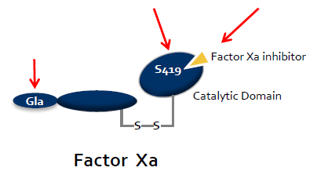
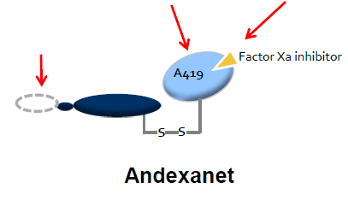
Andexanet: Reversal of Factor Xa Inhibitors
Recombinant engineered version of human factor Xa produced in CHO cells
Acts as a FXa decoy : high affinity for all FXa inhibitors
GLA domain removed to prevent anticoagulant effect
Crowther M et al. oral presentation at AHA November 2014; Chicago, Illinois , USA.

Slide 45
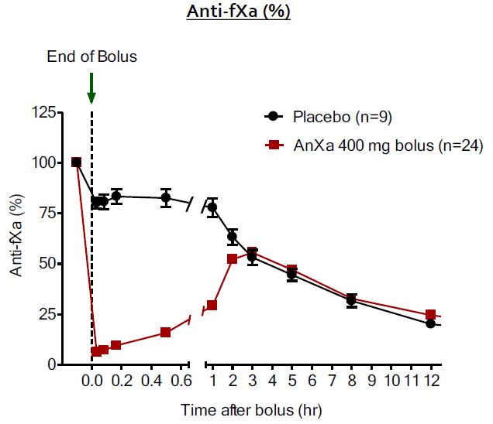
ANNEXA™-A (Apixaban, Part 1):
Primary Endpoint Anti-FXa
Met primary endpoint:
  Percent change anti-FXa from baseline to nadir (94%)
    P<0.0001
  Met first secondary endpoint:
  Number of subjects with >80% reversal: andexanet alfa (100%) vs. placebo (0%)
    P<0.0001
  All andexanet alfa subjects achieved ≥90% reversal
Data plotted as mean ± SEM.
fXa = factor Xa.
Crowther M et al. oral presentation at AHA November 2014; Chicago, Illinois , USA.
Notes:
This slide shows the percentage change in anti-FXa activity from baseline (measurement at peak concentration before start of bolus) to nadir (smaller value of 2 or 5 minutes post end of bolus) in Part 1 of the ANNEXA-A study.
Andexanet alfa reduced the concentration of anti-FXa by 94% from baseline to nadir (P<0.0001).
In the andexanet alfa group, 100% of subjects had >80% reversal compared with 0% in the placebo group (P<0.0001).
All subjects treated with andexanet alfa achieved ≥90% reversal.
Crowther M, Levy G, Lu G, et al. ANNEXA™-A: a phase 3 randomized, double-blind, placebo-controlled trial, demonstrating reversal of apixaban-induced anticoagulation in older subjects by andexanet alfa (PRT064445), a universal antidote for factor Xa (fXa) inhibitors. Oral presentation at: AHA 2014; November 15-19, 2014; Chicago, IL, USA.

Slide 46
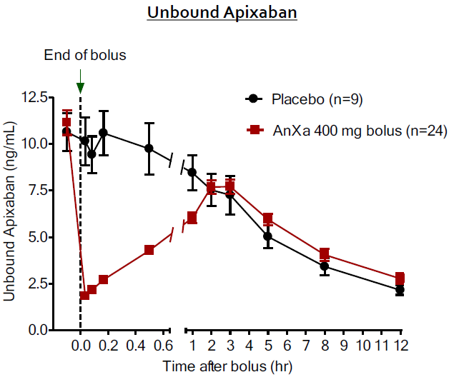
ANNEXA™-A (Apixaban, Part 1):
Secondary Endpoint: Unbound Apixaban
Met secondary endpoint:
  Change in free apixaban concentration from baseline to nadir (1.8 ng/mL)
    P<0.0001
  Consistent with Phase 2 data
Data plotted as mean ± SEM
Crowther M et al. oral presentation at AHA November 2014; Chicago, Illinois , USA.
Notes:
This slide shows the change in free apixaban concentration from baseline to nadir in Part 1 of the ANNEXA-A study.
Consistent with phase 2 data, andexanet alfa significantly reduced the amount of unbound apixaban compared with placebo (P<0.0001).
Andexanet alfa reduced the concentration of unbound apixaban to 1.8 ng/mL.
Crowther M, Levy G, Lu G, et al. ANNEXA™-A: a phase 3 randomized, double-blind, placebo-controlled trial, demonstrating reversal of apixaban-induced anticoagulation in older subjects by andexanet alfa (PRT064445), a universal antidote for factor Xa (fXa) inhibitors. Oral presentation at: AHA 2014; November 15-19, 2014; Chicago, IL, USA.

Slide 47
PATIENT RECEIVING RIVAROXABAN THERAPY: HAEMORRHAGE PROTOCOL
STOP: RIVAROXABAN
Contact Haematologist
Request: 1. Coagulation screen to include PT (INR), APTT (consider thrombin time)
[Important to document time of last dose of RIVAROXABAN]
2. Full blood count and renal function / eGFR
PT (and TT) normal
PT (and TT) prolonged
NO Rivaroxaban anticoagulant effect likely to be present
Rivaroxaban anticoagulant effect maybe present (consider oral charcoal if Rivaroxaban ingestion < 2 hours)
MILD BLEED
MAJOR BLEED
LIFE THREATENING BLEED
Mechanical compression
Tranexamic Acid
- oral 25 mg/kg
- i.v. 15 mg/kg
Delay next Rivaroxaban dose
or discontinue treatment
Maintain BP and Urine Output
Optimise tissue oxygenation
Control haemorrhage
- Compression
- Surgical intervention
Tranexamic Acid (25 mg/kg i.v.)
Red Cell transfusion
- Aim Hb > 7 g/dl
Platelet transfusion
- Aim Plt > 50 x 10⁹/l or
- If CNS bleed aim Plt > 100 x 10⁹/l
Prothrombin Complex Concentrate
(PCC)
- Beriplex 35 - 50 U/kg or
- Octaplex 40 U/kg (max 3000 U in one dose)
Continues to bleed
Major Bleed: Symptomatic bleeding in a critical area or organ, such as intracranial, intraspinal, intraocular, retroperitoneal, intra-articular, pericardial or intramuscular with compartment syndrome

Slide 48
Major bleeding in warfarin patients
Review of PCC use in Good Hope 2014
55 patients received PCC
52 pts on warfarin 3 pts on rivaroxaban
14/52 died (26.9%)
similar to previous audits: 2011 - 30%; 2012 - 39%; 2013 - 19.8%.
consistently higher than international average of 10.6%¹.

Slide 49
Summary
BHH / GHH / SHH guidance is for DOAC use in VTE if applicable
Apixaban first choice
LMWH is still first line for cancer associated VTE
Warfarin an option if DOAC inappropriate; AKI, CYP 450 Inducers

Slide 50
Any Questions?

